Slide 1
cavity-cavity interaction

Slide 2
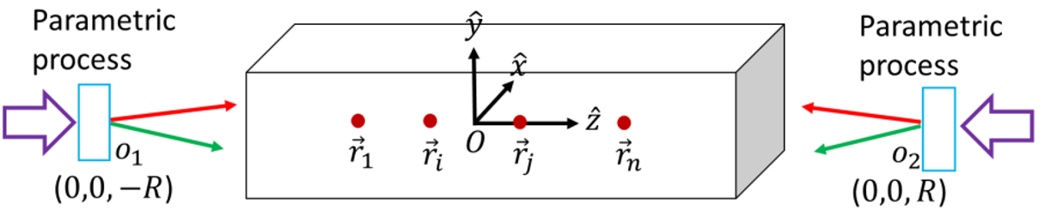
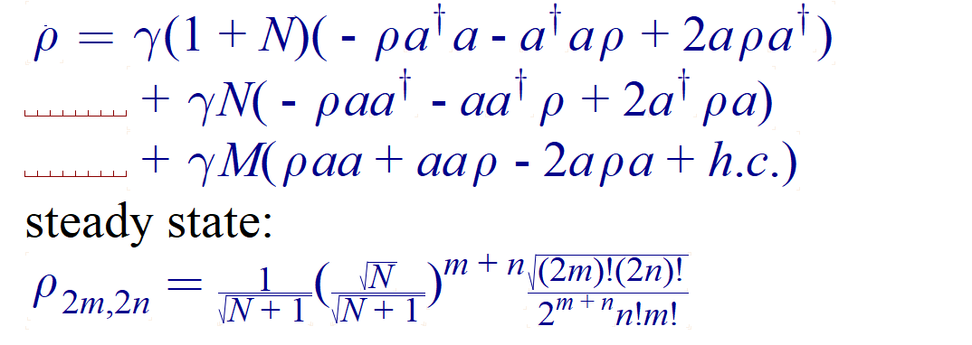

$$r_{i}$$

Slide 3
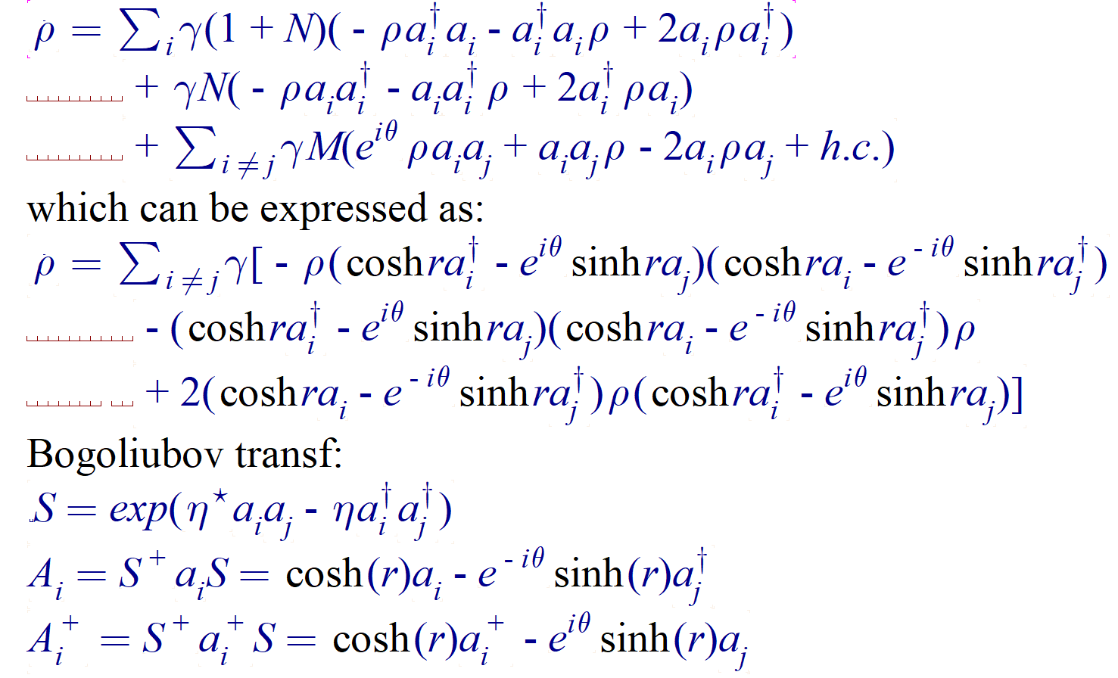
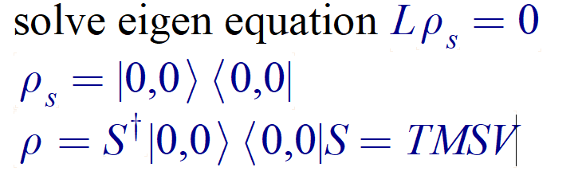


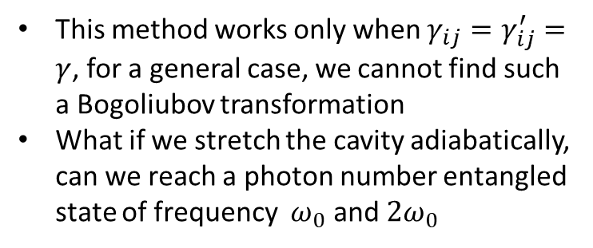
$$ν_{1}=ω_{0}+δ$$
$$ν_{1}=ω_{0}−δ$$
This method works only when $γ_{ij}=γ_{ij}^{′}=γ$, for a general case, we cannot find such a Bogoliubov transformation
What if we stretch the cavity adiabatically, can we reach a photon number entangled state of frequency $ω_{0}$ and $2ω_{0}$

Slide 4
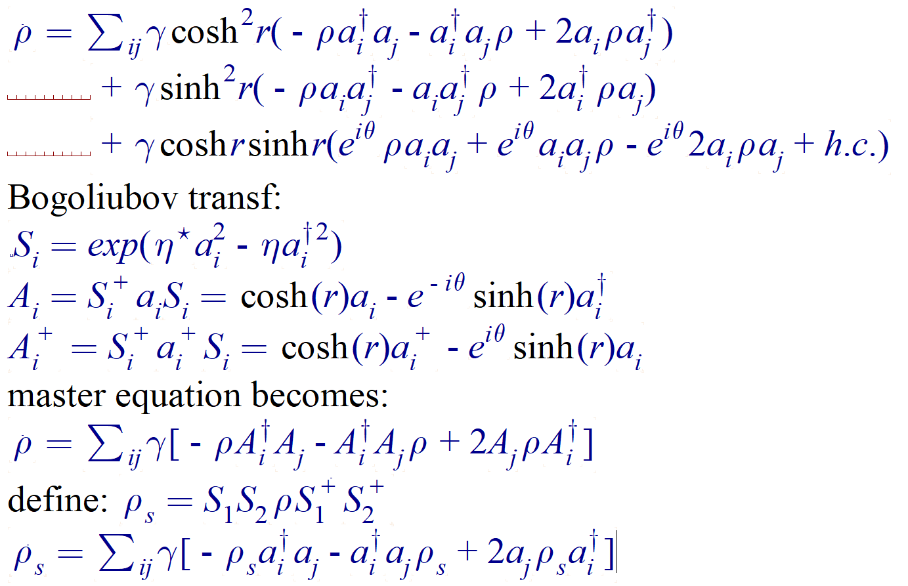
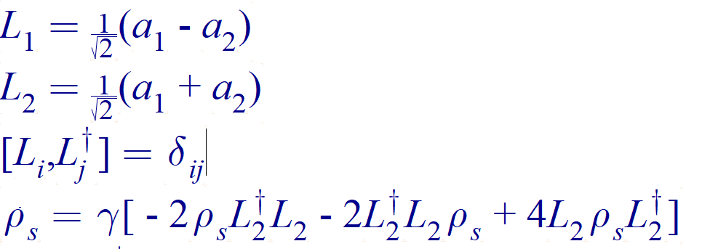
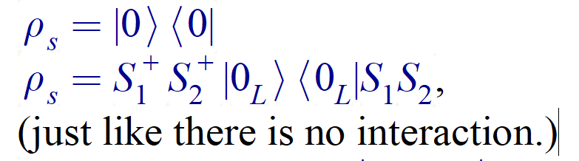


$$ν_{1}=ω_{0}$$
$$ν_{1}=ω_{0}$$
This is just one solution!

Slide 5
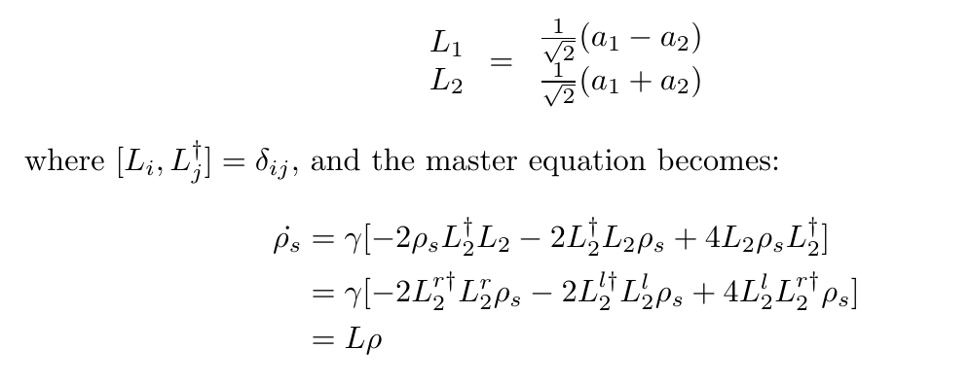
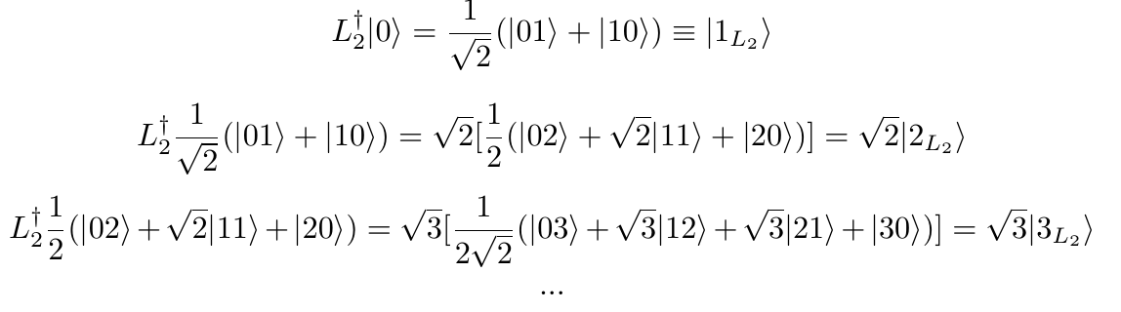
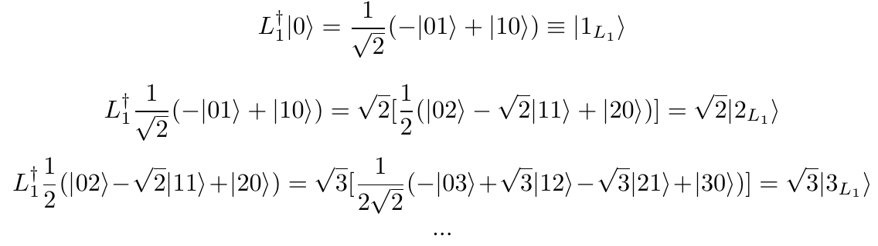
general solution:

